Slide 1
Embedding Diagnostic Errors Work into a Patient Safety Program
Karen Johnson BSN, RN, CCMSCP
Senior Director, Patient Safety, BH
Karen.Johnson@baystatehealth.org
Harry Hoar III, MD
Pediatric Hospitalist & Clinician Educator, BH
Harry.HoarIIIMD@baystatehealth.org
Notes:
HH
We have no disclosures
40 minutes for presentation
Focus on practical take homes for institutions to use immediately

Slide 2
Overview
Describe one organization’s strategy for reducing harm from delayed and missed diagnosis
Describe two ways to adapt current patient safety processes to improve diagnosis
Notes:
HH

Slide 3
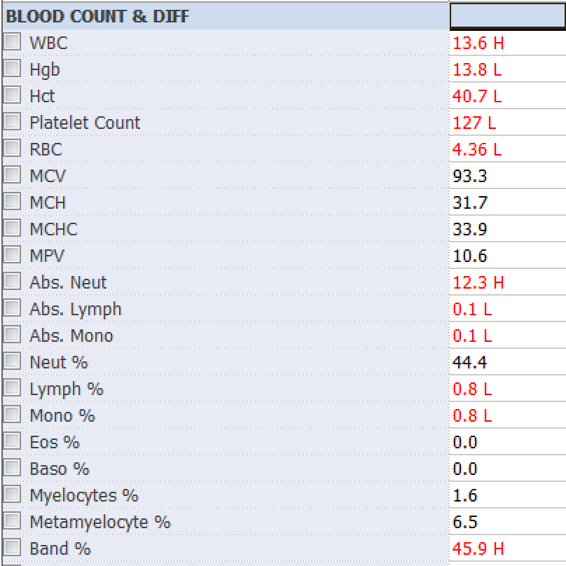
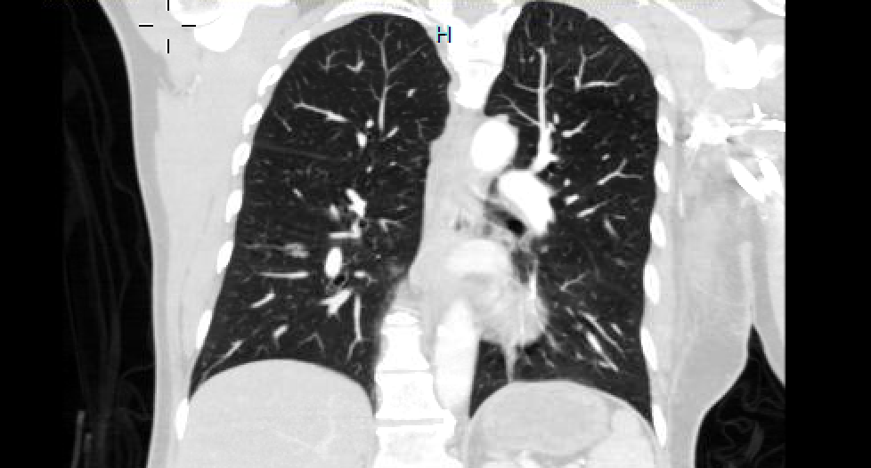
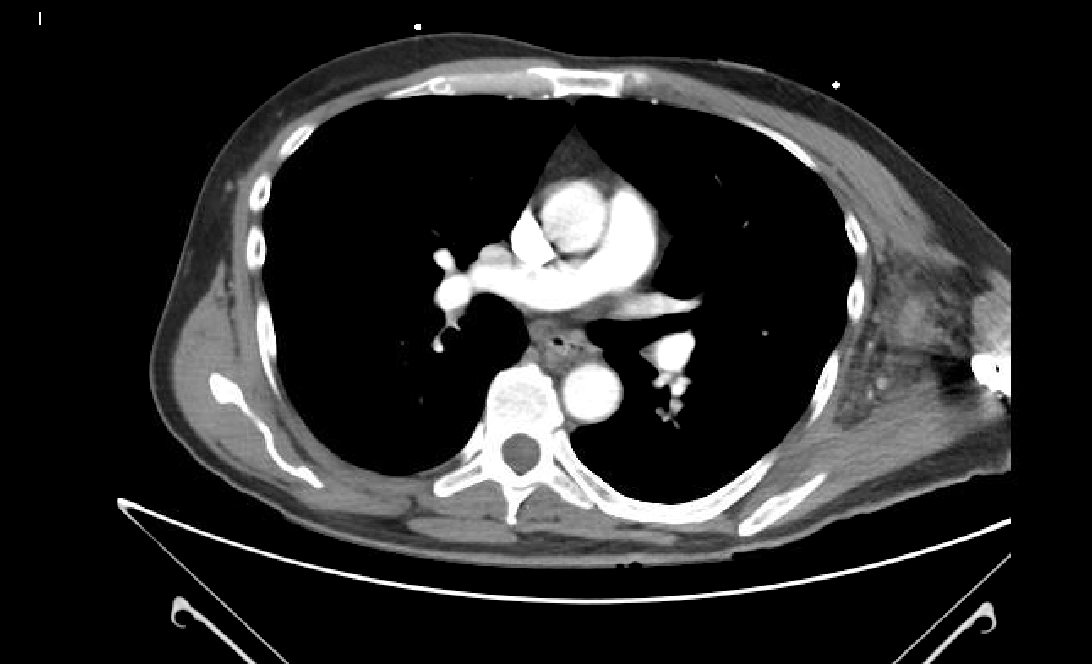
Notes:
HH
This case was presented during the hospital medicine program’s relatively new M&M series.
59yo previously healthy man with left-sided chest and arm pain.
also reported having some fever and chills
His blood pressure was low on presentation but improved with fluids.
pain was pleuritic and reproducible to palpation.
An EKG showed some ST elevation in a few leads but his troponins were negative so he was not felt to be having ACS.
A CT angiogram was performed to rule out an aortic dissection, the radiologist read it as a normal study with no evidence of dissection.
Cardiology evaluated him and felt that he had pericarditis- treatment was started.
In his labs, a bandemia of 49% was noted and commented on in the resident’s admission note as being of unknown significance. Blood cultures were ordered.
By the next day, the blood cultures had not been drawn and he was continued on treatment for pericarditis. His band count came down to 24%, blood cultures were re-ordered, the plan was to continue to watch him off of antibiotics. By the next day, he was in shock, went to the ICU, the blood cultures grew gram positive cocci. Physical exam revealed an easily palpable mass in the left lateral chest/armpit. Re-review of the CT showed clear evidence of an infection in that area. The abscess was drained but the patient died of overwhelming Group A strep sepsis.

Slide 4
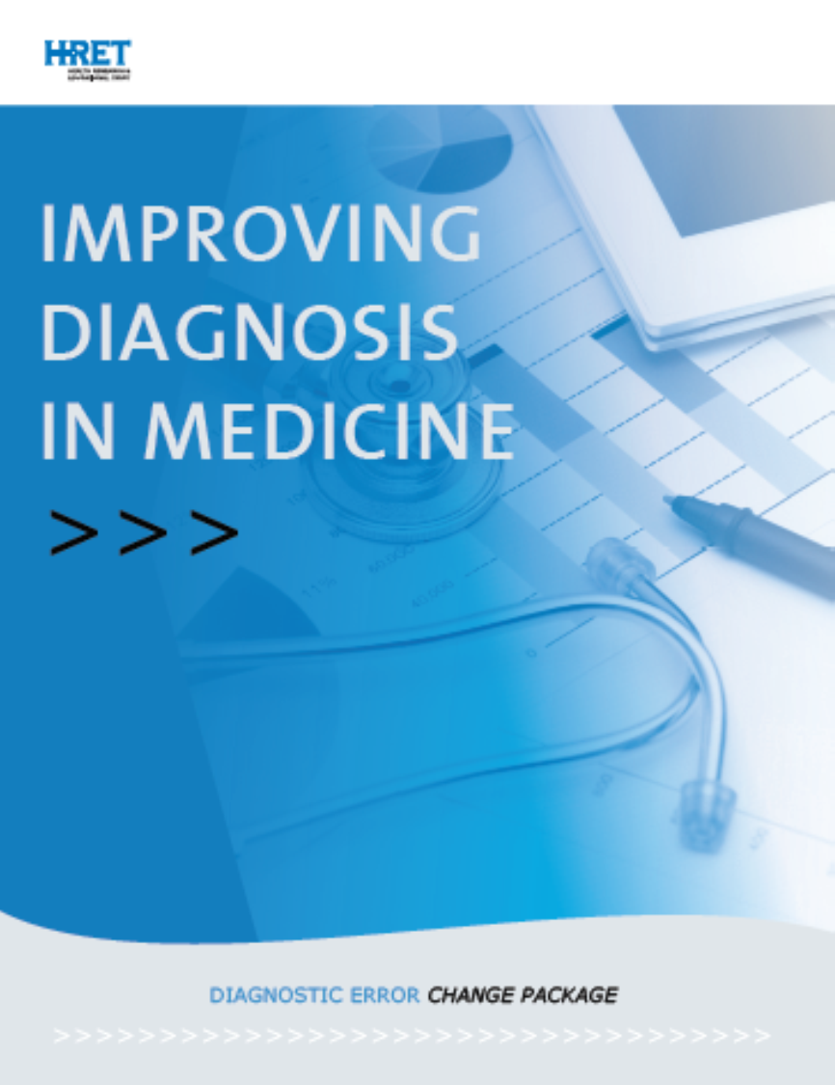
Health Research & Educational Trust (September 2018). Improving Diagnosis in Medicine Change Package. Chicago, IL: Health Research & Educational Trust.
Accessed at:
http://www.hret-hiin.org/
Notes:
HH
HRET commissioned this report from the SIDM, included DS and BT, released in September, it provides a toolkit for institutions interested in improving diagnostic reliability.

Slide 5
AIM PRIMARY SECONDARY DRIVERS
DRIVERS
Effective Teamwork
Diagnostic teams include diverse health care disciplines and patients
and families
Diagnostic teams model PFE and culture of safety principles and practices
Organizational structures optimized for diagnostic safety
Reliable Diagnostic Process
Clinical operations and information flow effectiveness
Accessible specialty expertise
Engaged Patients and Family Members (PFE)
Patient and family members on diagnostic team
IMPROVE DIAGNOSIS TO REDUCE HARM
Patient and family partnership in diagnosis improvement,
Governance, policy, and in error reporting and follow-up
Effective clinical decision support
Optimized Cognitive Performance
Clinical reasoning abilities
Reflective practice
Diagnostic error identification
Robust Learning Systems
Diagnostic performance feedback
Continuous learning about diagnosis
Notes:
HH

Slide 6
Using the Drivers as a Road Map
Effective Teamwork
Reliable Diagnostic Process
Engaged Patients and Family Members
Optimized Cognitive Performance
Robust Learning Systems
Notes:
HH handoff to KJ

Slide 7
Robust Learning Systems
Board Engagement:
  Board Harm Report
Transparency:
  Analysis of local Malpractice Claims Data
Identify Diagnostic Error Cases
Analyze Cases for Contributors:
  Root Cause Analysis
  Morbidity and Mortality
Notes:
KJ

Slide 8
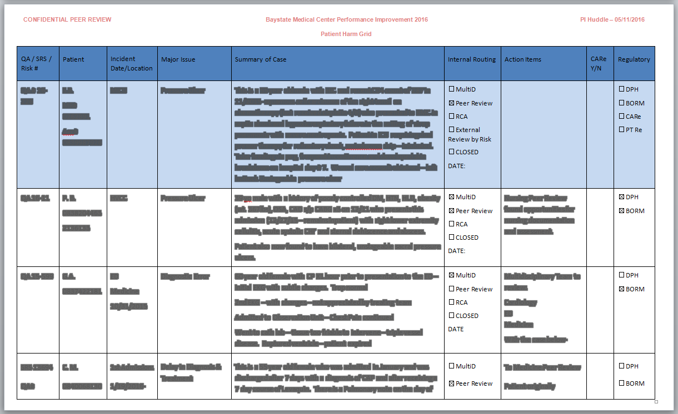
Identifying Diagnostic Errors
Diagnostic
Delay
Diagnostic
Error
In the first 13 months, 62 of 201 cases (31%) were potential diagnostic errors
Notes:
KJ

Slide 9
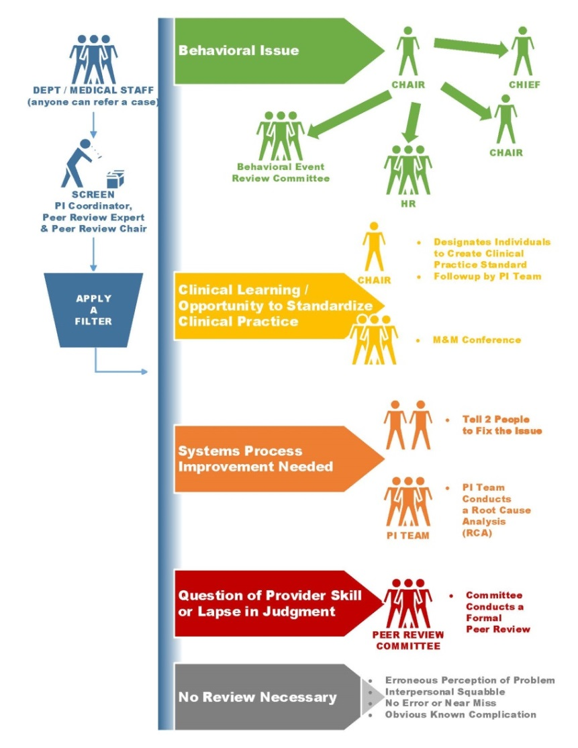
Case Filter Tool
Weekly PI Huddle
Notes:
KJ

Slide 10
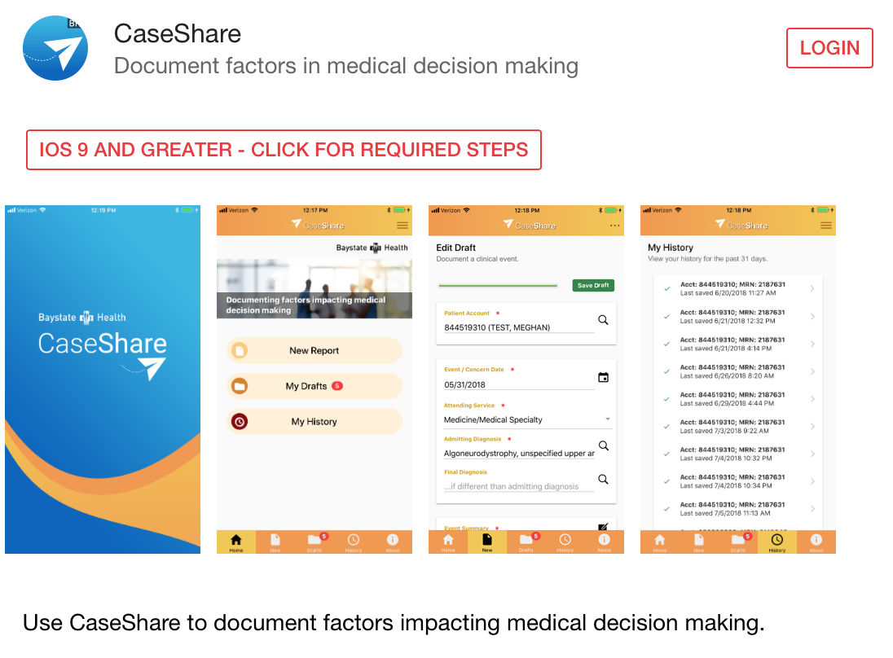
Diagnostic Reporting App
Notes:
KJ
Collaboration with Tech spring
Novel

Slide 11
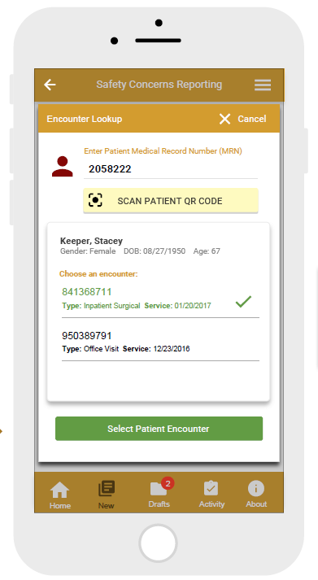
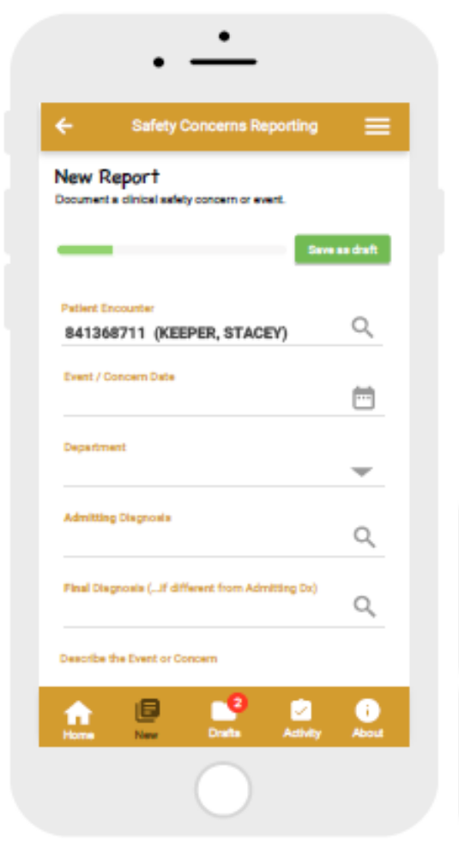

Diagnostic Errors Reporting System
Dr. Chris Bryson
Notes:
KJ

Slide 12
Notes:
KJ

Slide 13
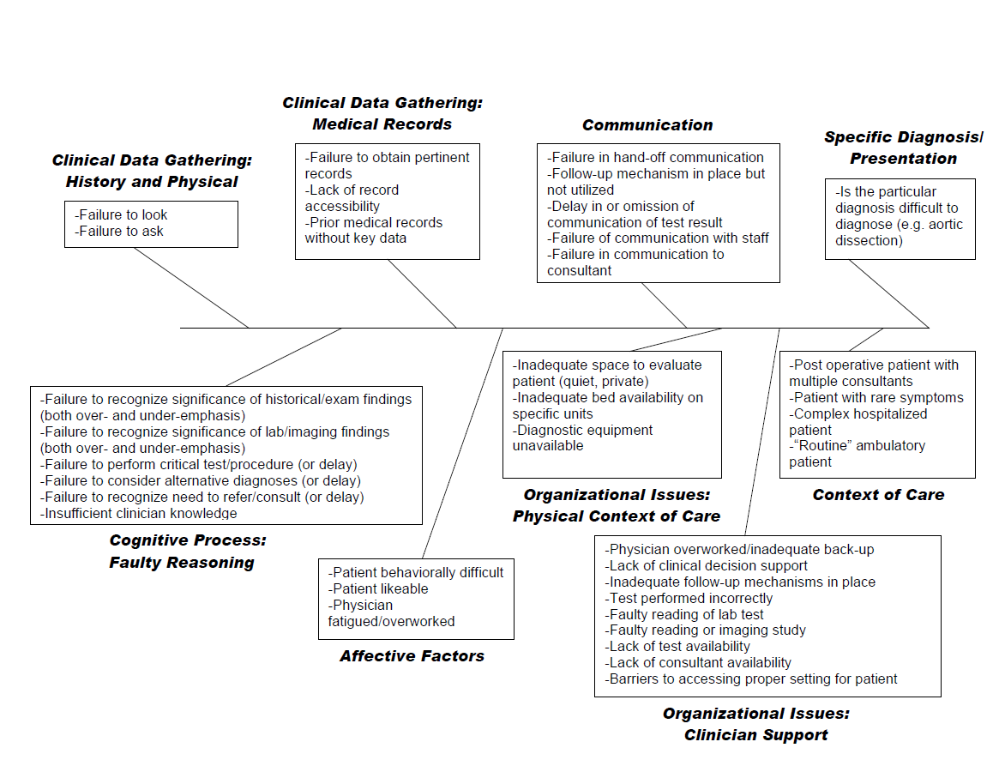
Analyzing Diagnostic Errors
Notes:
Failure to look/palpate the lateral chest wall/axilla
Failure to recognize the significance of the fever and chills and the reproducible nature of the pain
Failure to recognize the significance of the band count
Failure to consider alternative diagnosis other than pericarditis
Busy ED shift, busy resident and supervising hospitalist
Failure in nursing handover to report that blood cultures had not been drawn
Failure of the floor nurse and resident to note that the blood culture had not been drawn
Bed space issues- patient remained in the ED waiting for a cardiac bed
Challenging diagnosis
As mentioned, not enough resident supervision
Radiologist missed the findings on CT
Cardiology consultant was not immediately available
Multiple cognitive biases at play

Slide 14
Using the Drivers as a Road Map
Effective Teamwork
Reliable Diagnostic Process
Engaged Patients and Family Members
Optimized Cognitive Performance
Robust Learning Systems
Notes:
KJ
Teamwork with risk management, centralized and decentralized approach
Close relationship between medical staff and quality/safety team
PFAC member on patient safety committee

Slide 15
Using the Drivers as a Road Map
Effective Teamwork
Reliable Diagnostic Process
Engaged Patients and Family Members
Optimized Cognitive Performance
Robust Learning Systems
Notes:
HH- There are multiple examples, we’ll talk about 2 in particular

Slide 16
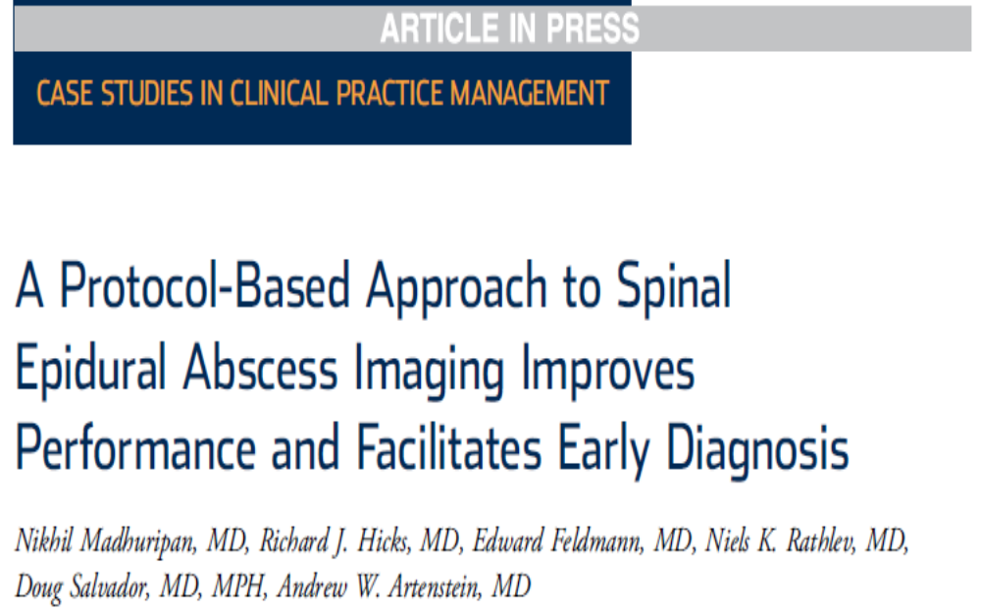
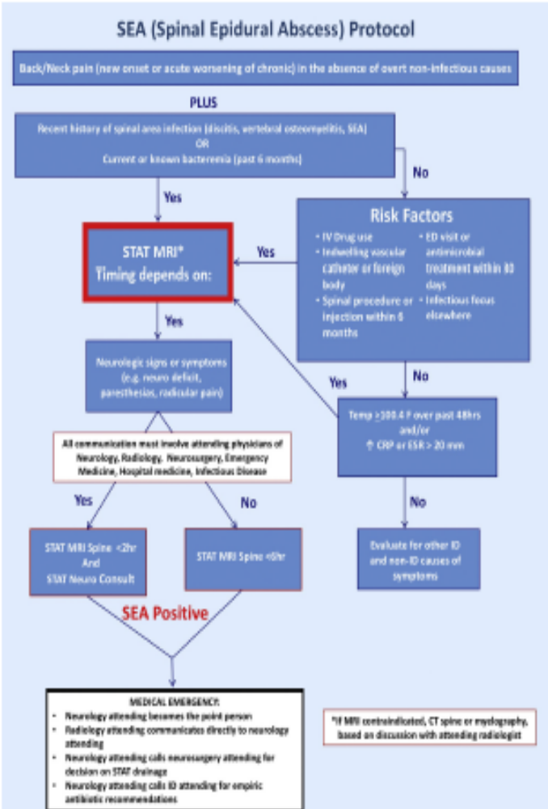
SEA Diagnostic Algorithm
Notes:
HH

Slide 17
Radiology Reporting
Notes:
HH
Hospitalist group in their learning got interested in how radiology reports are interpreted based on Superficial thrombophlebitis vs DVT
Compare old report to new report
Check with Steve O’Connor/Chris Bryson

Slide 18
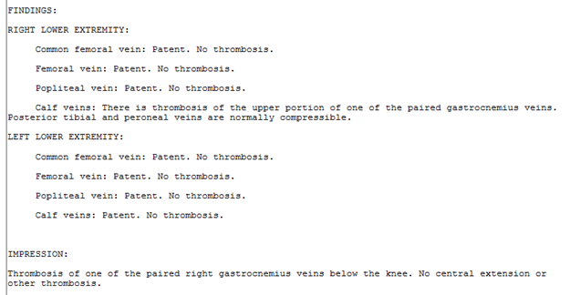
Before

Slide 19
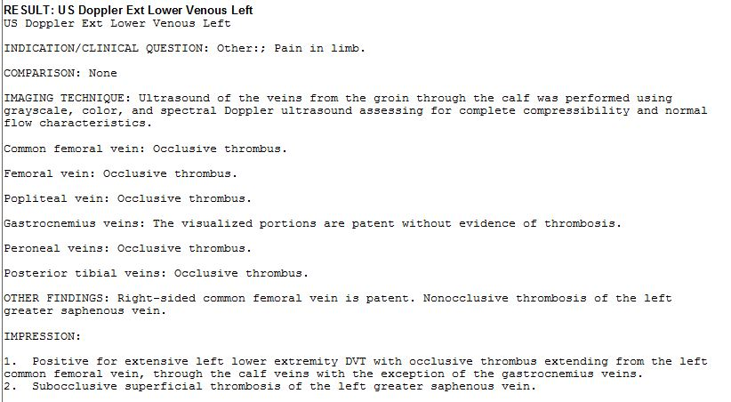
After

Slide 20
Using the Drivers as a Road Map
Effective Teamwork
Reliable Diagnostic Process
Engaged Patients and Family Members
Optimized Cognitive Performance
Robust Learning Systems
Notes:
HH

Slide 21
Comprehensive Educational Approach to Improve Clinical Reasoning
Associate Designated Institutional Officer
Undergraduate Medical Education:
  Key theme for medical school
Graduate Medical Education:
  Morning Report
  ED conference
Continuing Medical Education:
  Grand Rounds, Visiting Professors
  Faculty Development
Notes:
HH
Add picture of HH and BT

Slide 22
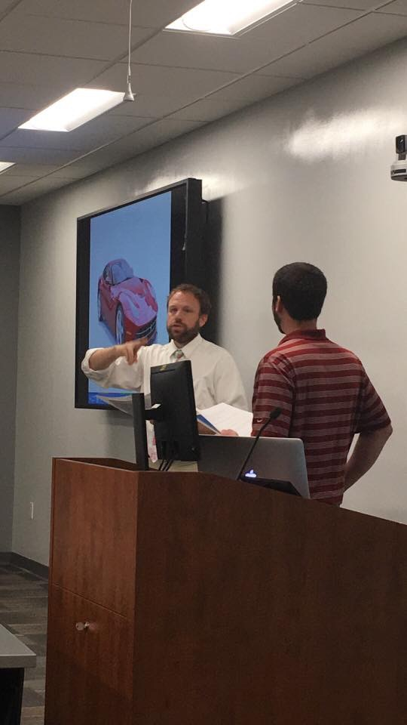
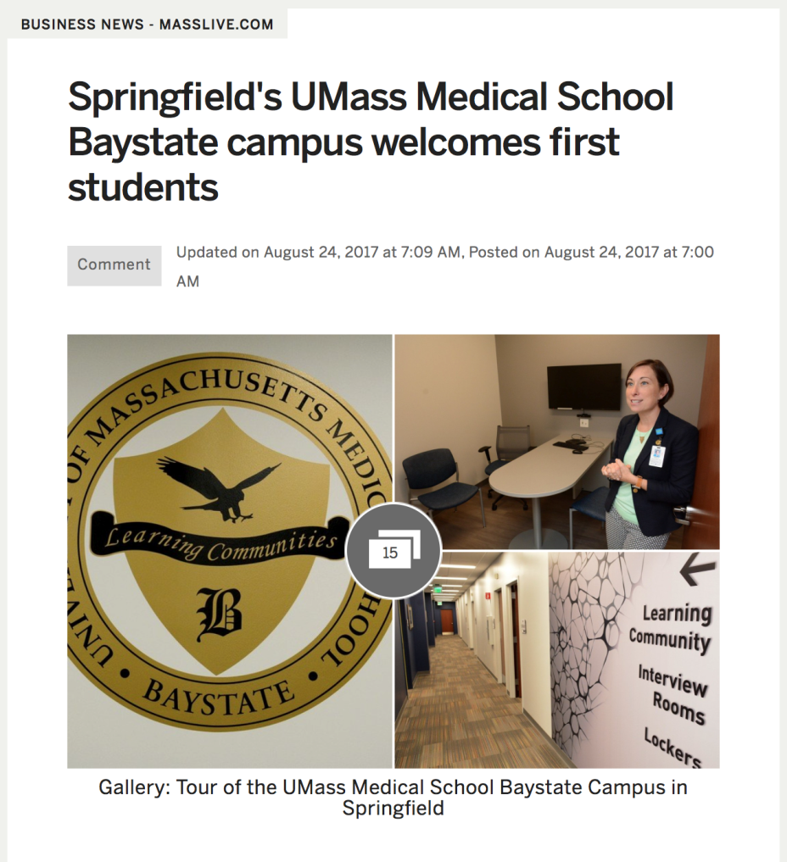
Notes:
HH

Slide 23
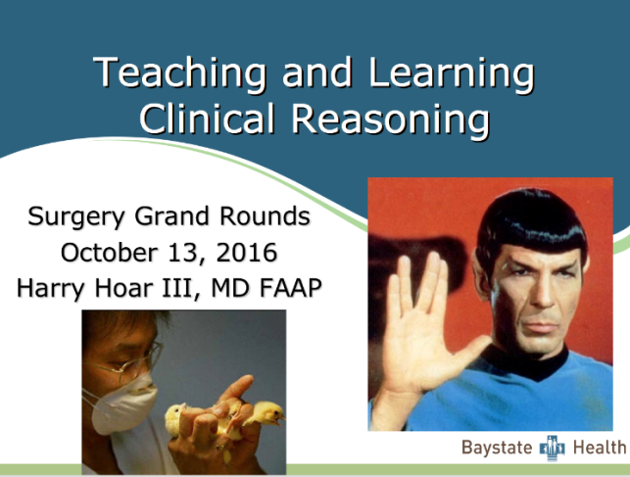
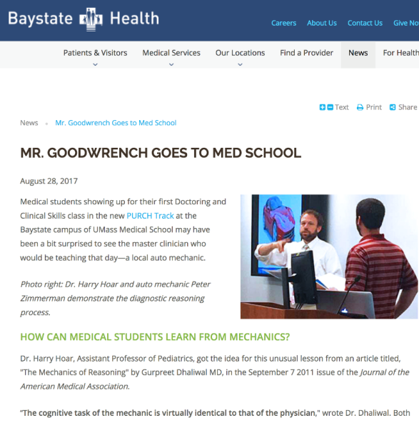

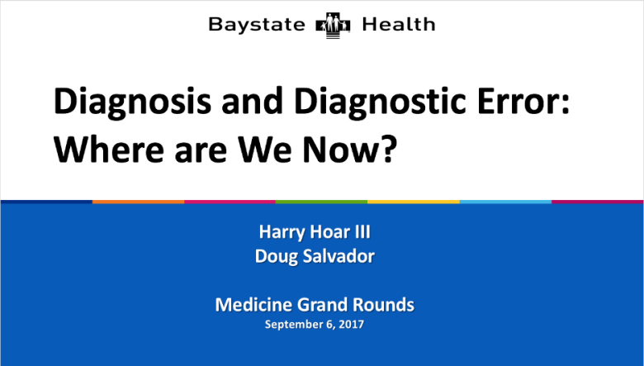
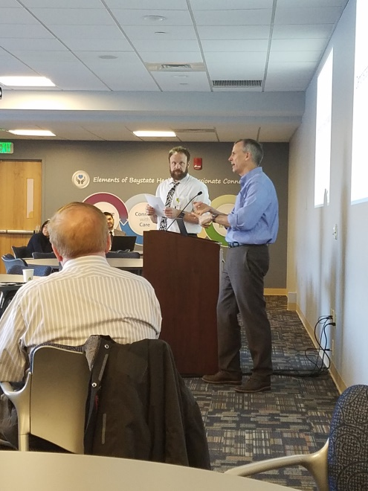
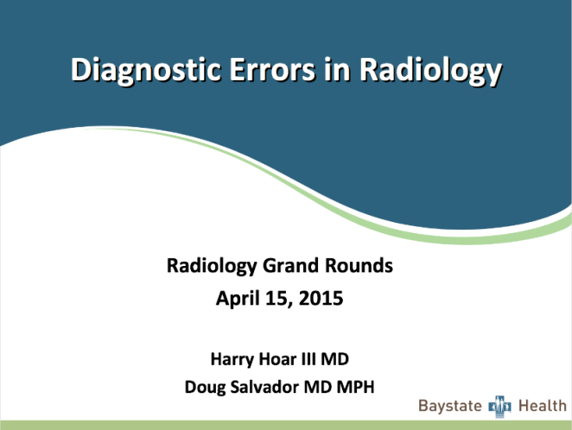

Education
Notes:
HH
Hospitalist M&Ms, departmental grand rounds, resident education

Slide 24
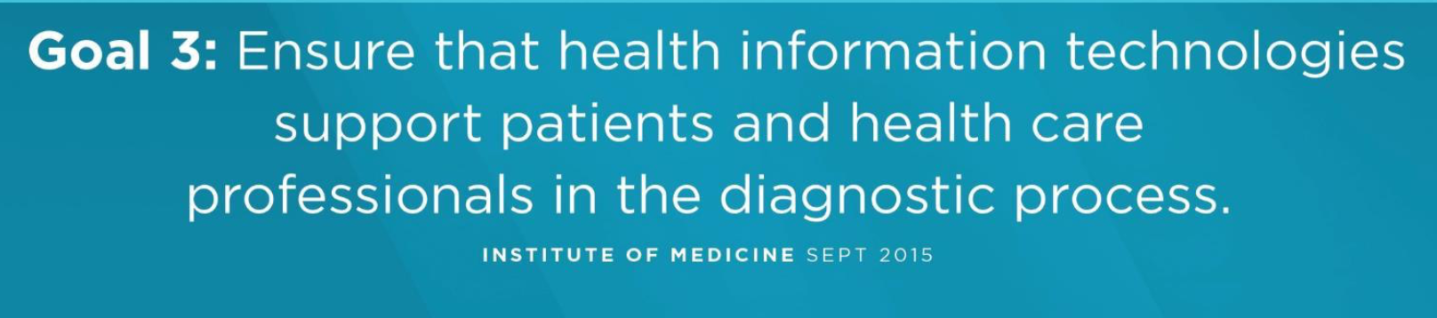
Clinical Decision Support
Notes:
HH
Proposal to BHIC to fund
Some visualdx stuff here- commitments from ED, hospital medicine, pediatrics to use it for clinical and education

Slide 25

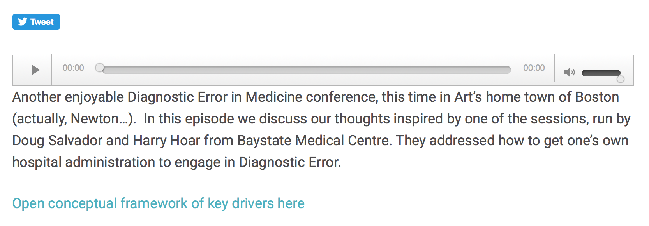
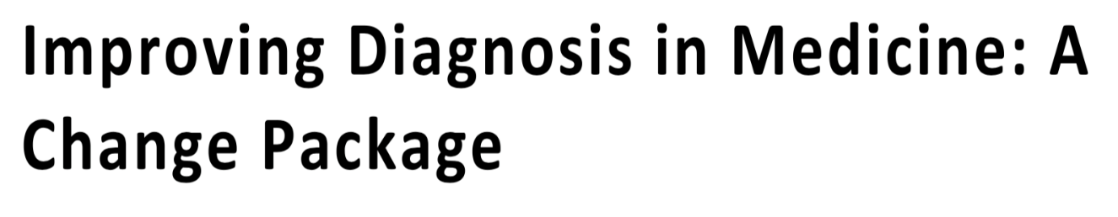
Partnering with Other Organizations
Notes:
PRIDE here
SIDM- screenshot IM reasoning podcast
Change package (HRET- AHA)
Upcoming- AHRQ, Macy foundation learning collaborative, malpractice insurers

